Slide 1
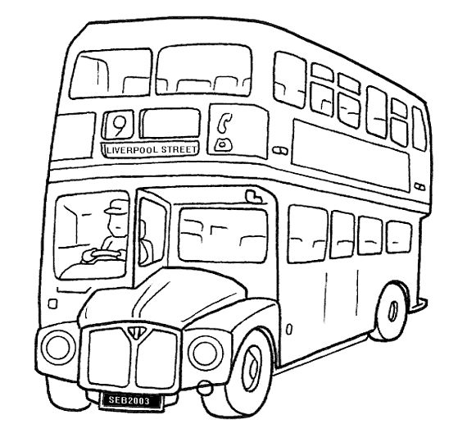
English
copybook
CE_
School year 2017/2018

Slide 2
English
copybook
CE_
School year 2017/2018

